Slide 1


Slide 2
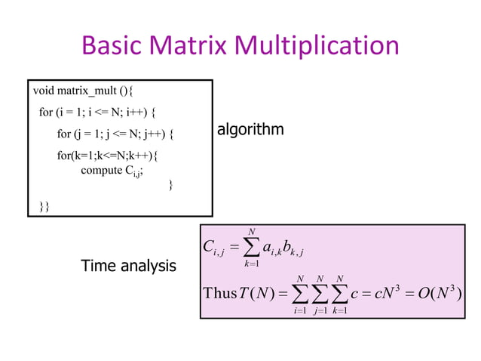

Slide 3
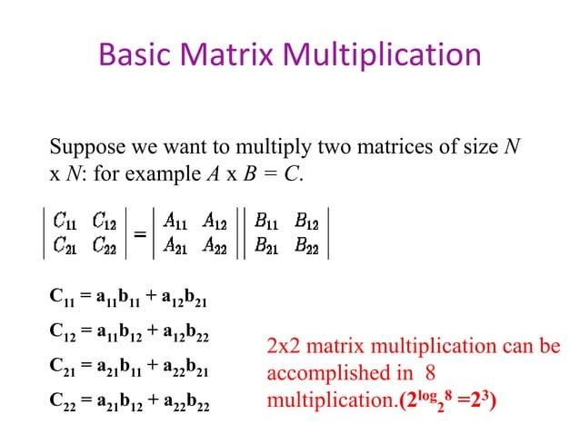

Slide 4
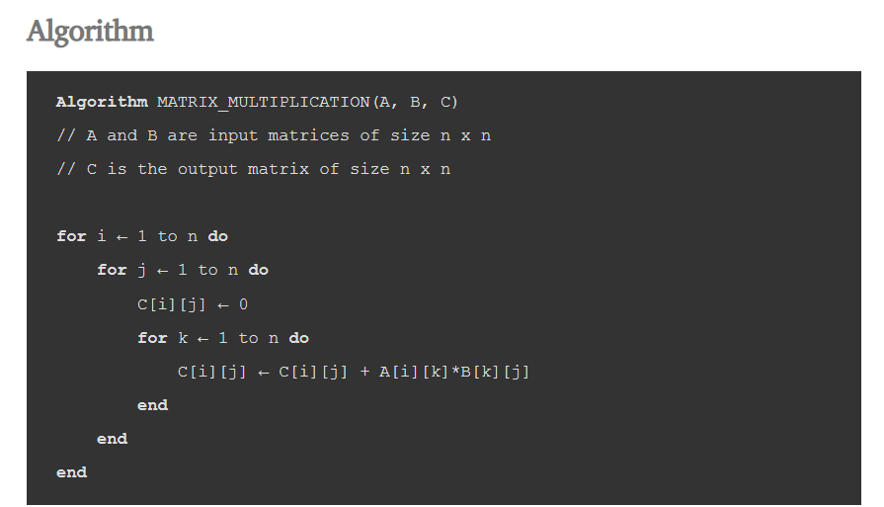

Slide 5
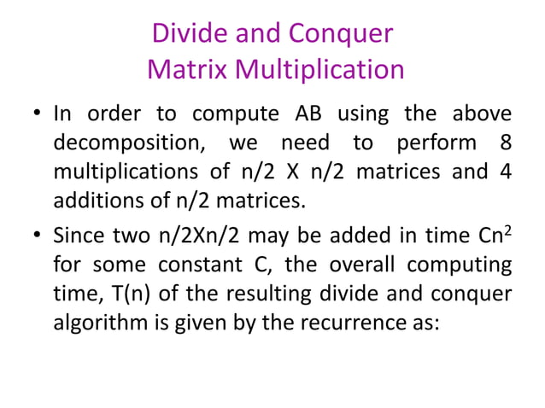

Slide 6
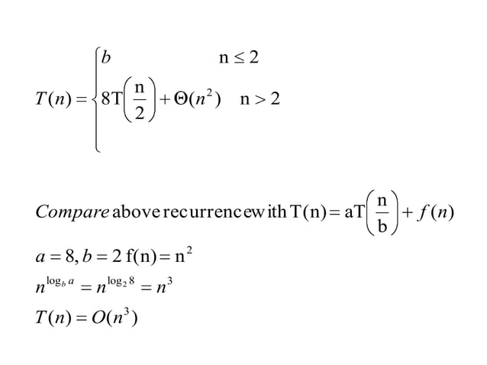

Slide 7
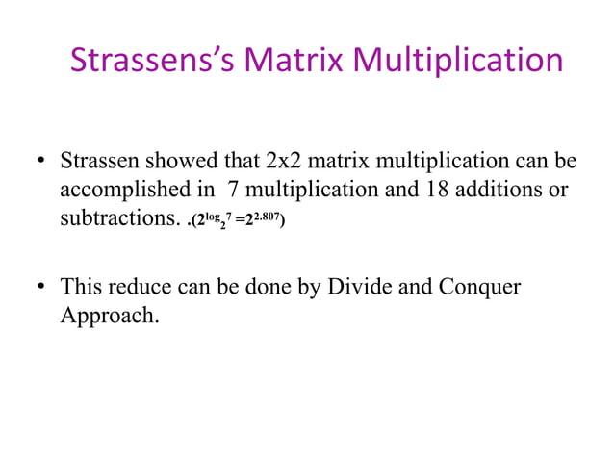

Slide 8
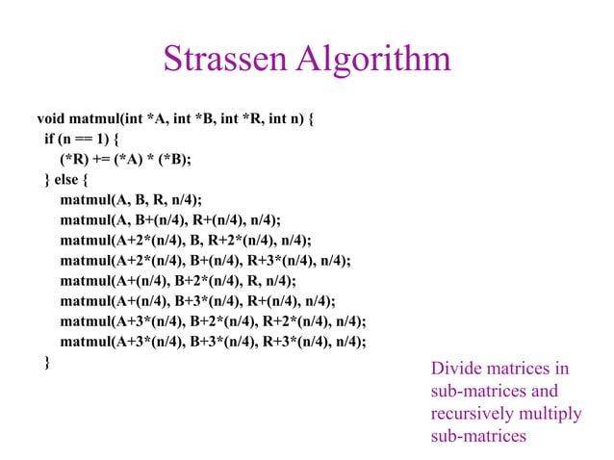

Slide 9
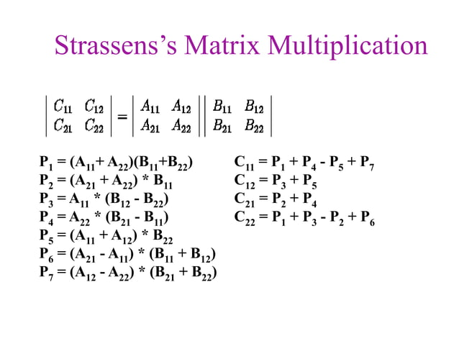

Slide 10
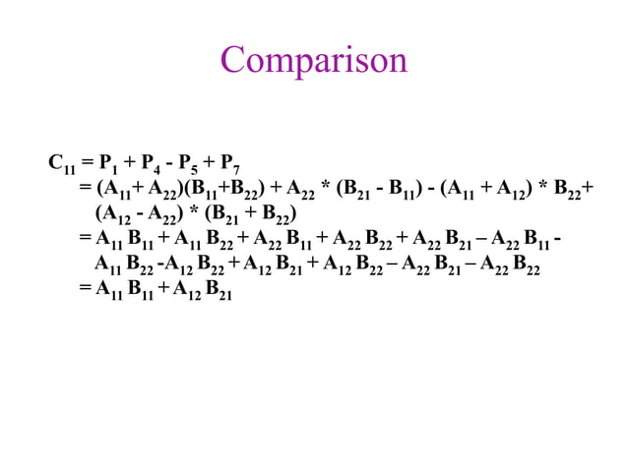

Slide 11
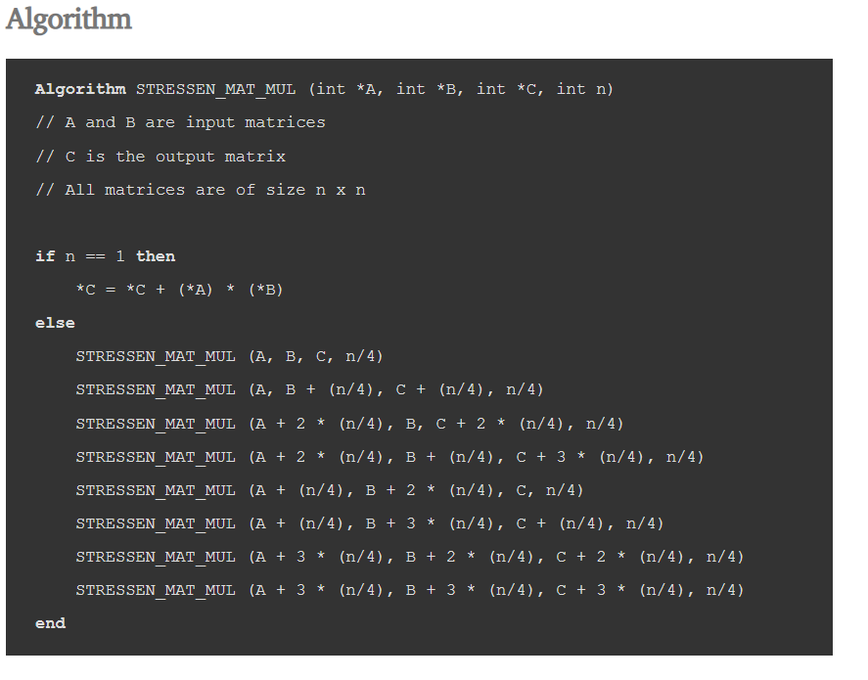

Slide 12
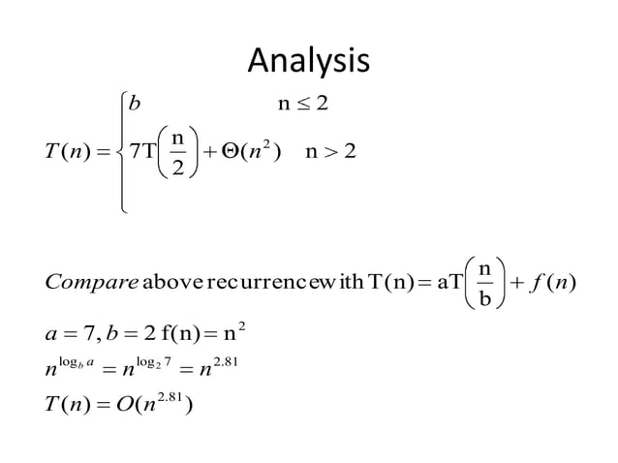

Slide 13
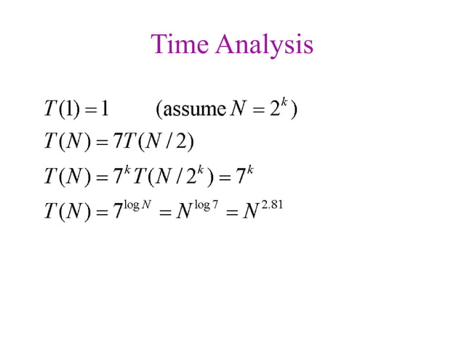

Slide 14
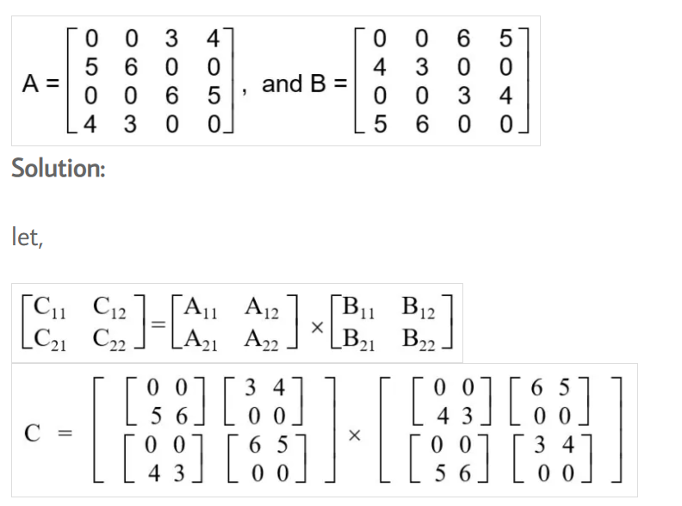
Example of Matrix Multiplication using Divide and Conquer Approach
Problem: Multiply given two matrices A and B using Strassen’s approach, where

Slide 15
let,
S₁ = (A₁₁ + A₂₂) x (B₁₁ + B₂₂)
S₂ = (A₂₁ + A₂₂) x B₁₁
S₃ = A₁₁ x (B₁₂ – B₂₂)
S₄ = A₂₂ x (B₂₁ – B₁₁)
S₅ = (A₁₁ + A₁₂) x B₂₂
S₆ = (A₁₁ – A₁₁) x (B₁₁ + B₁₂)
S₇ = (A₁₂ – A₂₂) x (B₂₁ + B₂₂)

Slide 16
